Slide 1
Blockchain Assignment Team Members: Surendar S : 2020MT93162 Sunny Khanuja : 2020MT93110
E-Voting Distributed application (DAPP) Using Blockchain

Slide 2
Objectives of the Application
Make the Election process easy and secure.
1
Avoid the waiting for my turn to vote (avoid queue-based waiting system)
2
Make the vote counting process easy.
3
Avoid DOUBLE VOTING (casting invalid votes)
4

Slide 3
Scope of this document
Steps to get started: UI application (React application) and running smart contracts.
UI walkthrough and explanation Note: Explanation Video link shared in this doc
Smart contracts explanation Note: Explanation Video link shared in this doc
Links to access the source-code and Explanation video
Now, Lets get started…..

Slide 4
Getting started: Deploy smart contracts
To deploy the Smart Contract
Install Ganache and create a workspace.
Install Truffle npm package globally by running `npm install -g truffle`
Run `truffle migrate --reset` from the command line to deploy the smart contract to the blockchain.
Download Metamask Chrome extension for the browser to help interaction between the application and the blockchain.
NOTE:
make sure to run ganache an appropriate port to connect it with metamask
Connect an account with local RPC network by using the private key of an account from ganache (this will grant 100ETH by default)

Slide 5
Getting started: Run react development server
To run the UI application locally
Run the command `npm install –no-optional` (To download the node modules to your local working directory)
In order to start the UI application run the following command, `npm start`
This will start the application in the localhost server.
NOTE: if the port is busy, then react will ask for confirmation to run in different port. The type in ‘y’ (Yes) to run the application.
This is start the application.

Slide 6
UI walkthrough – Explanation for different workflows
Login as Admin
managing election, voters and candidates
Login as Voter
for casting vote for a desired candidate

Slide 7

Admin workflow

Slide 8
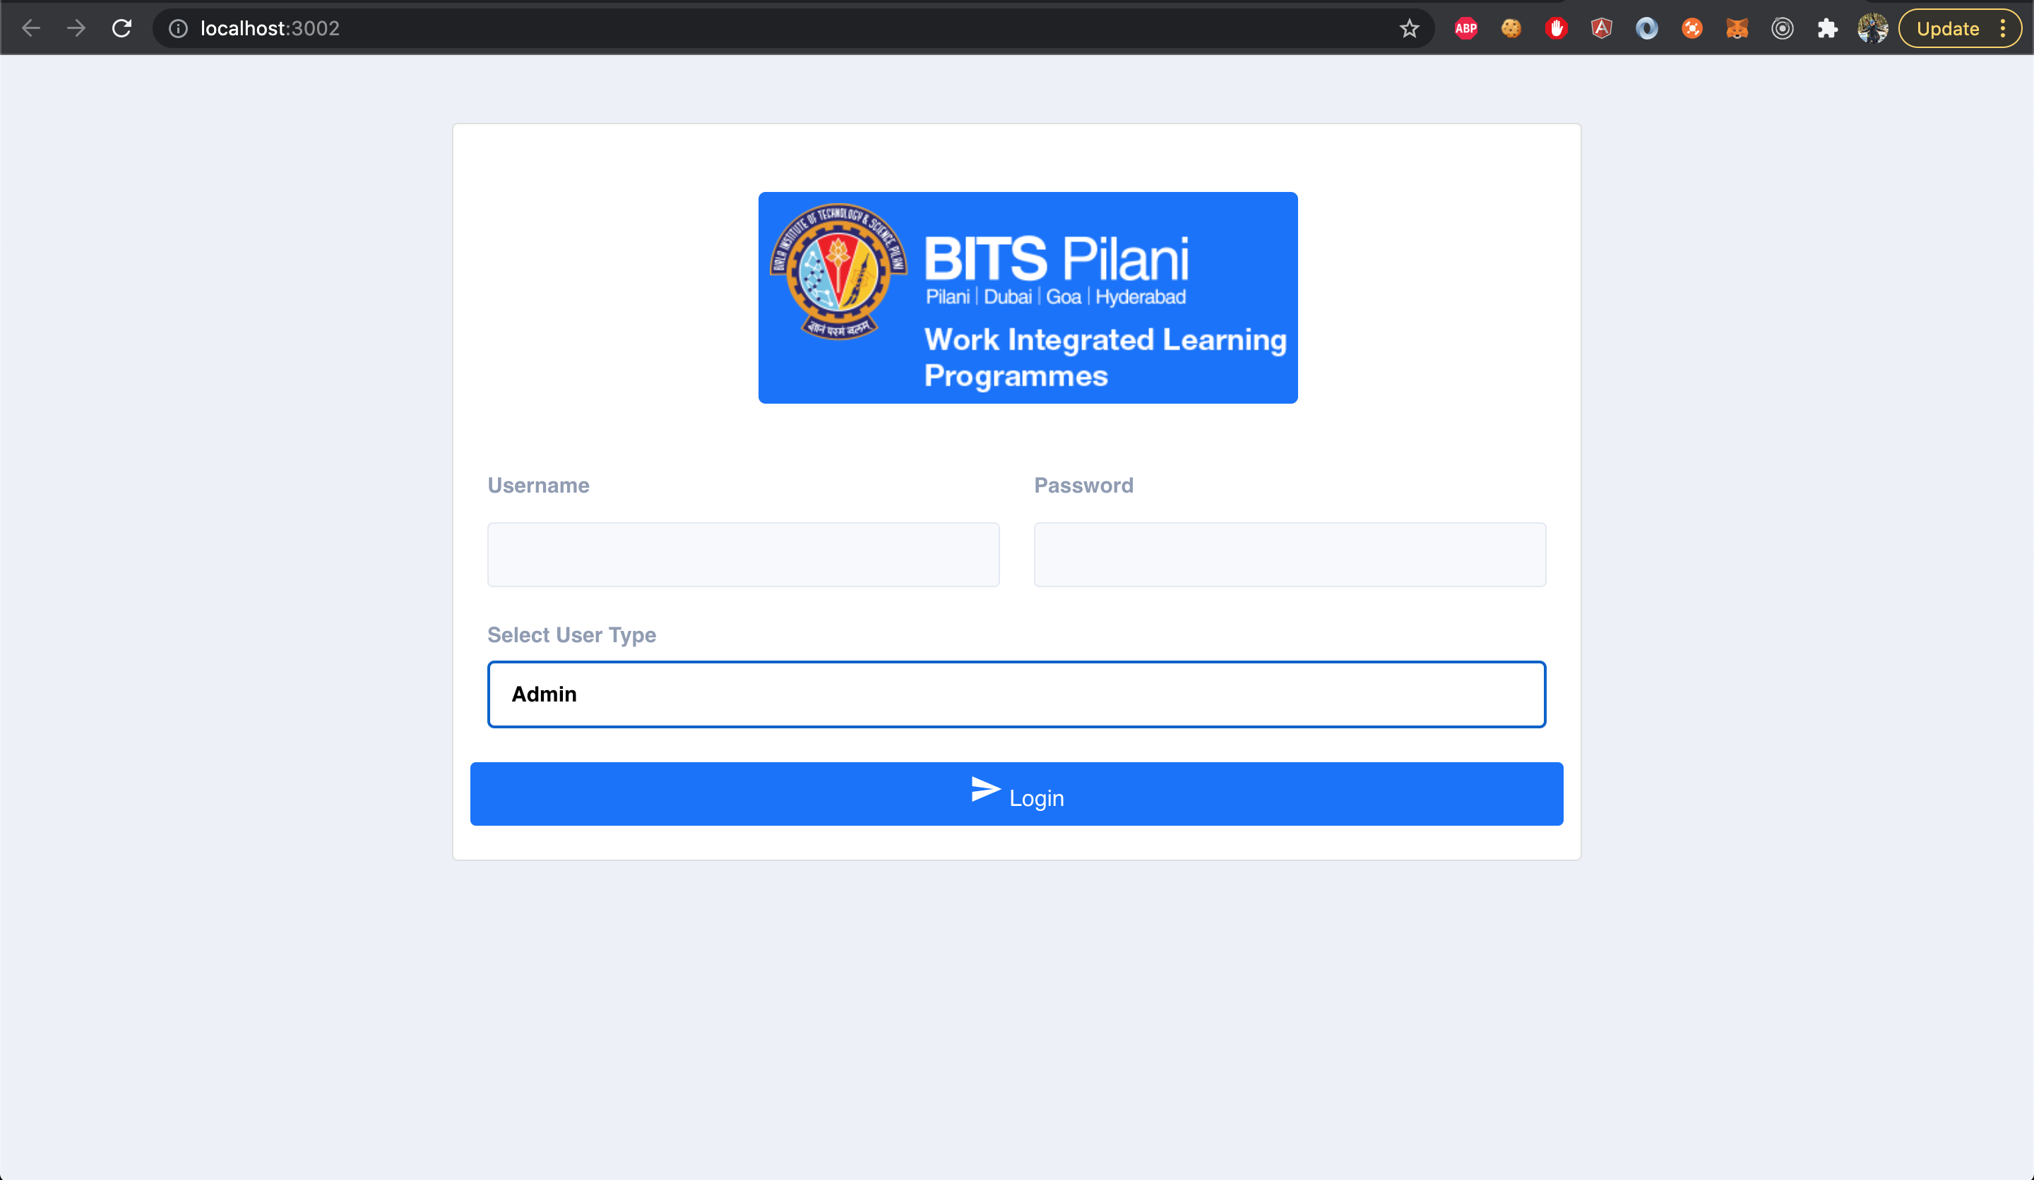
Login as Admin
This is how the landing page has been designed.
There are two types of User, Admin and Voter.
Admin has following privileges:
to create an Election (if not created before)
add candidates to election
Add voters
But they can’t cast a vote
Login Credentials:
Username: admin
Password: 12345

Slide 9
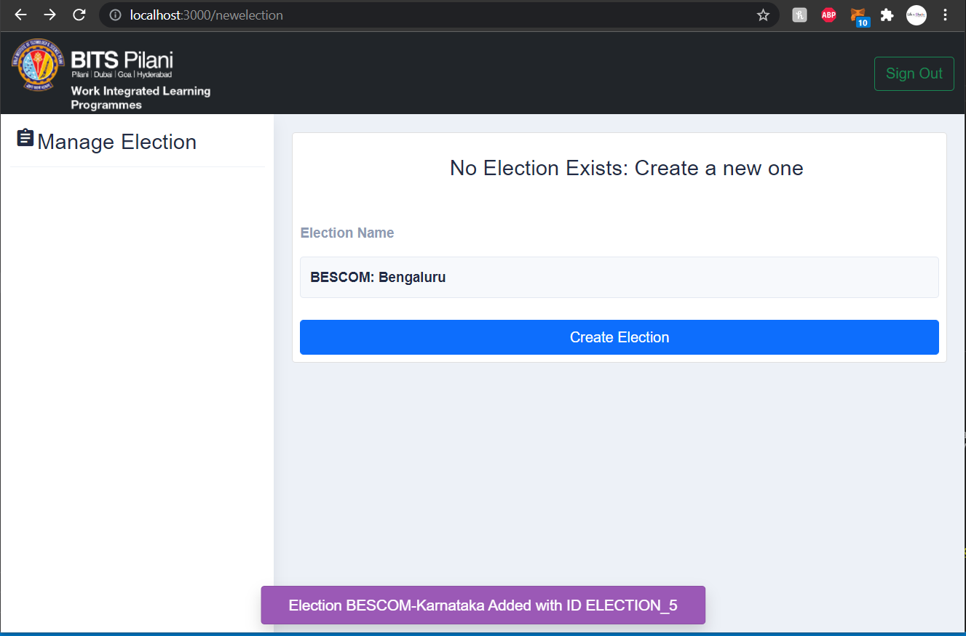
Create Election (For first time)
After a successful admin login, this is how the admin dashboard looks like.
The admin need to create the election for the first time.
With the help of “web3.js” we connect to the local Ethereum network (ganache) to store the election details.

Slide 10
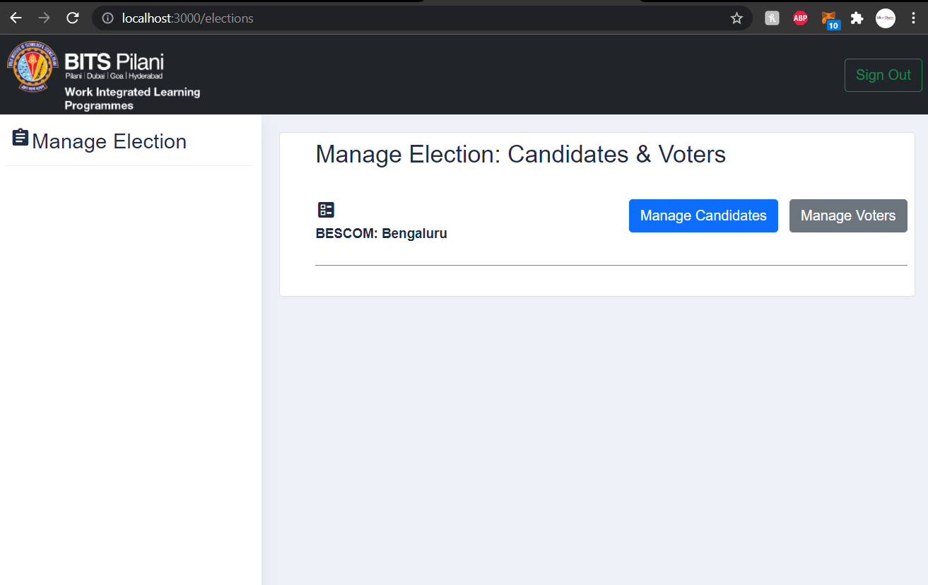
Manage Election
Once the Election is created, then the admin can start add candidates and voters.
As of now, there is a one-to-one mapping for the Election organizer (Admin) and the election smart contract.
This can be extended further to provide access to an organizer to handle multiple elections.

Slide 11
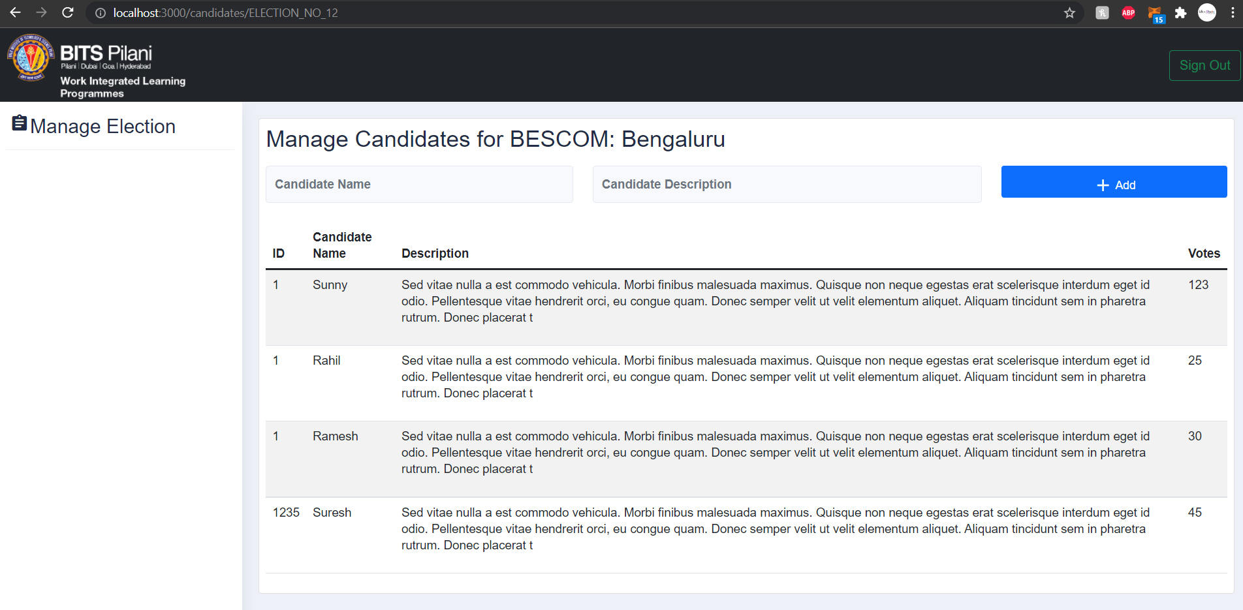
Managing Candidates
Once the Manage Candidates button is clicked, one can add the candidates under an election contract.
As of now, we store the
Candidate ID
Candidate name
Description
Vote count

Slide 12
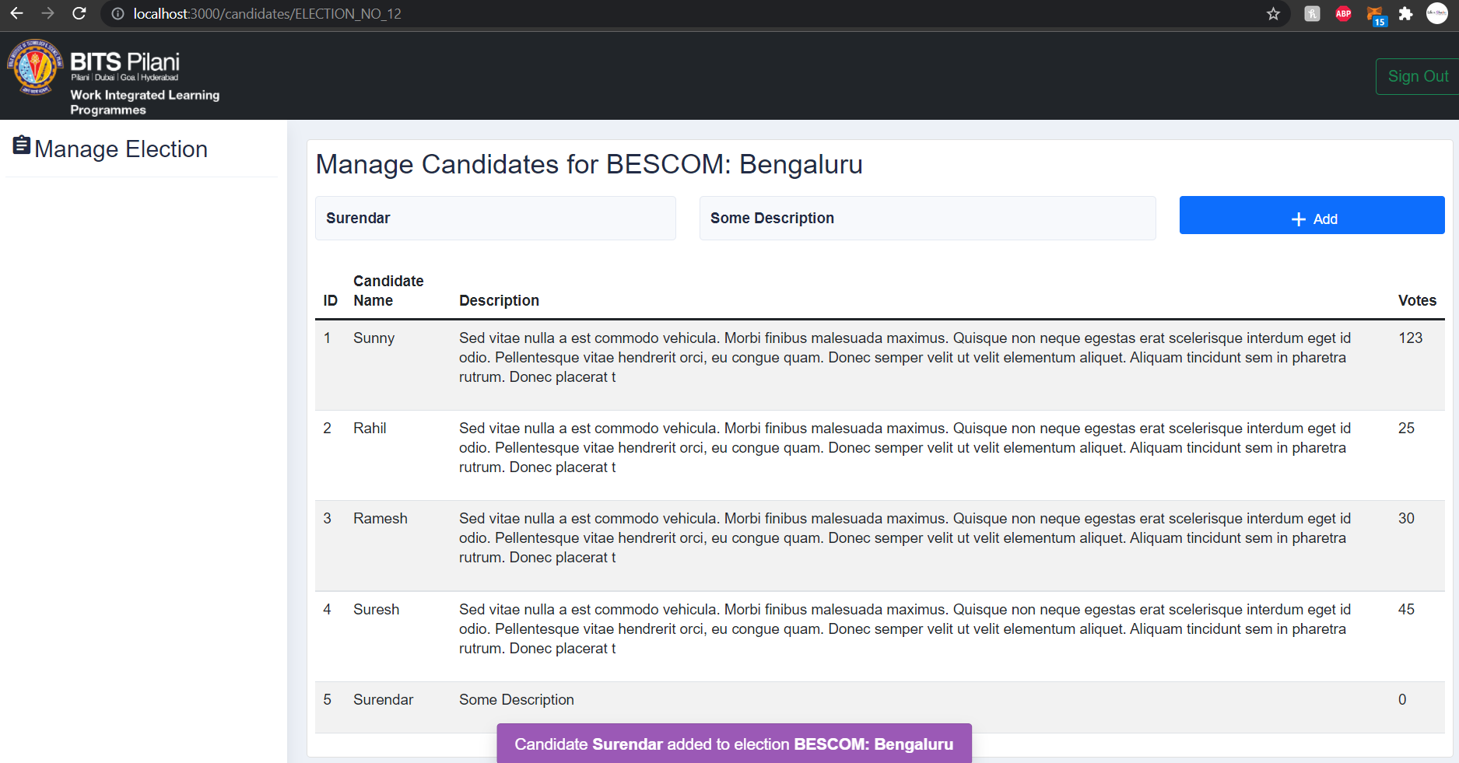
Adding Candidate to Election
When the add button is clicked, then the candidate will be added to the blockchain data.
The newly added candidate can be seen in the below list of candidate.

Slide 13
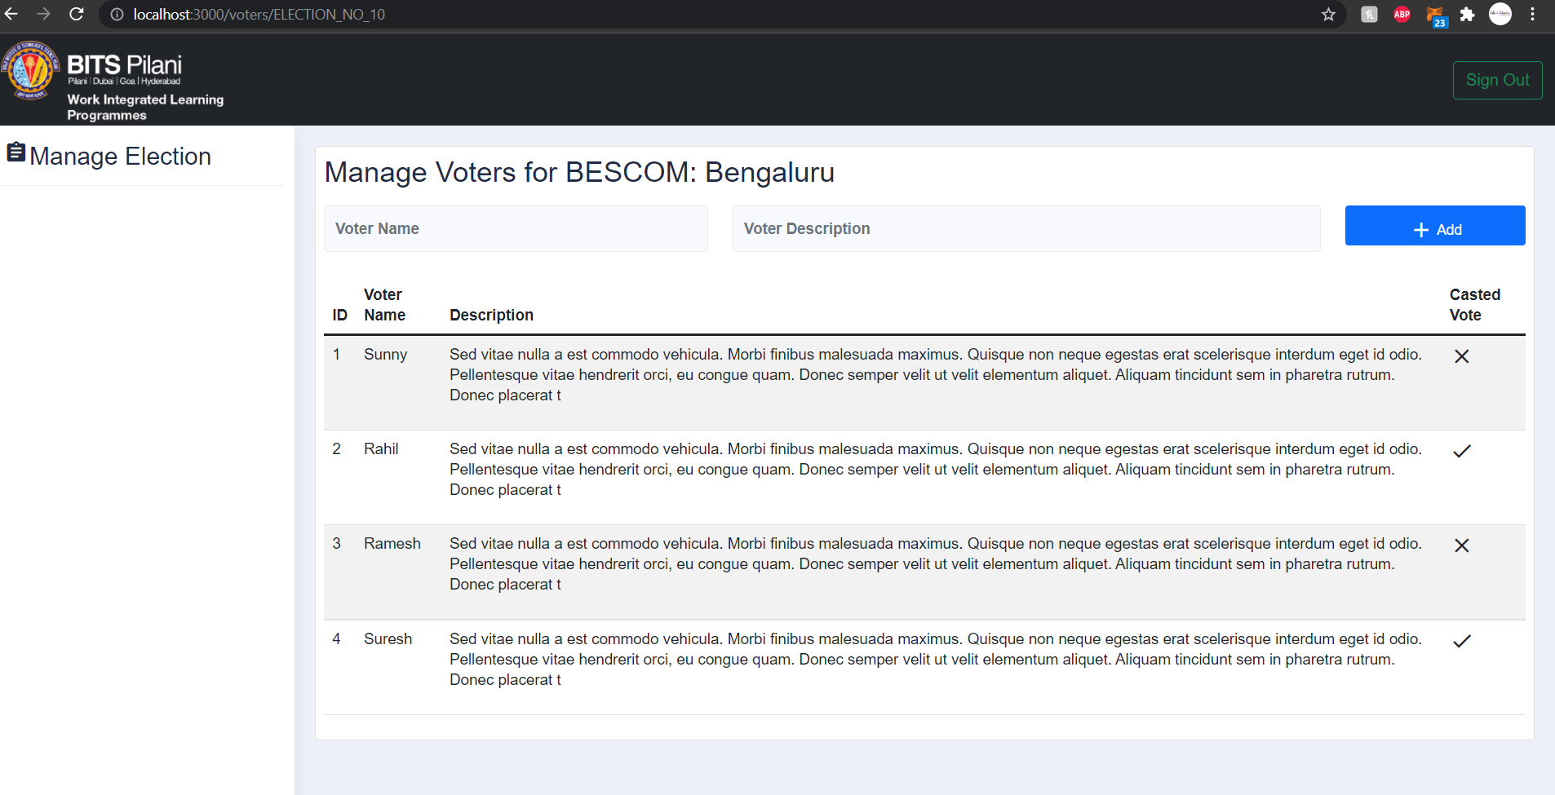
Manage Voters
When manage voter button is clicked, one can manage the list of voters by adding them.
As of now, we store the
Voter ID
Voter name
Description
If voter Casted a vote or not

Slide 14
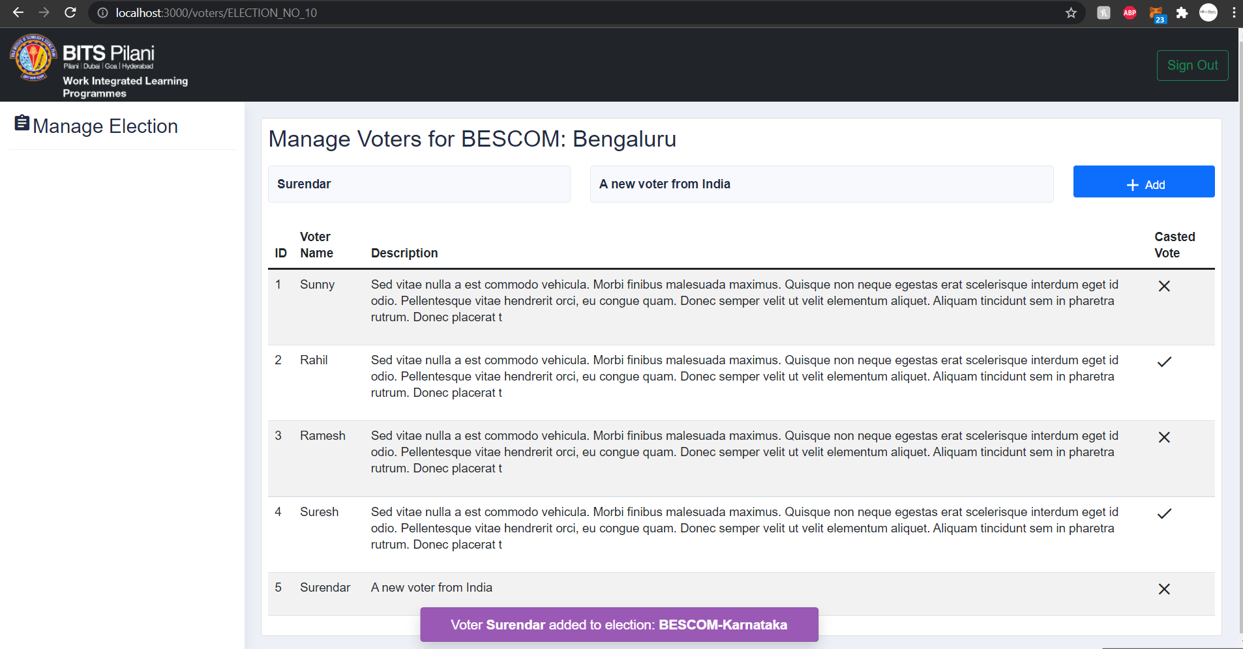
Manage Voters: Add new Voter
When the add button is clicked, then the voter information will be added to the blockchain data under the current Election.
The newly added candidate can be seen in the below list of candidate.

Slide 15
Voter workflow

Slide 16
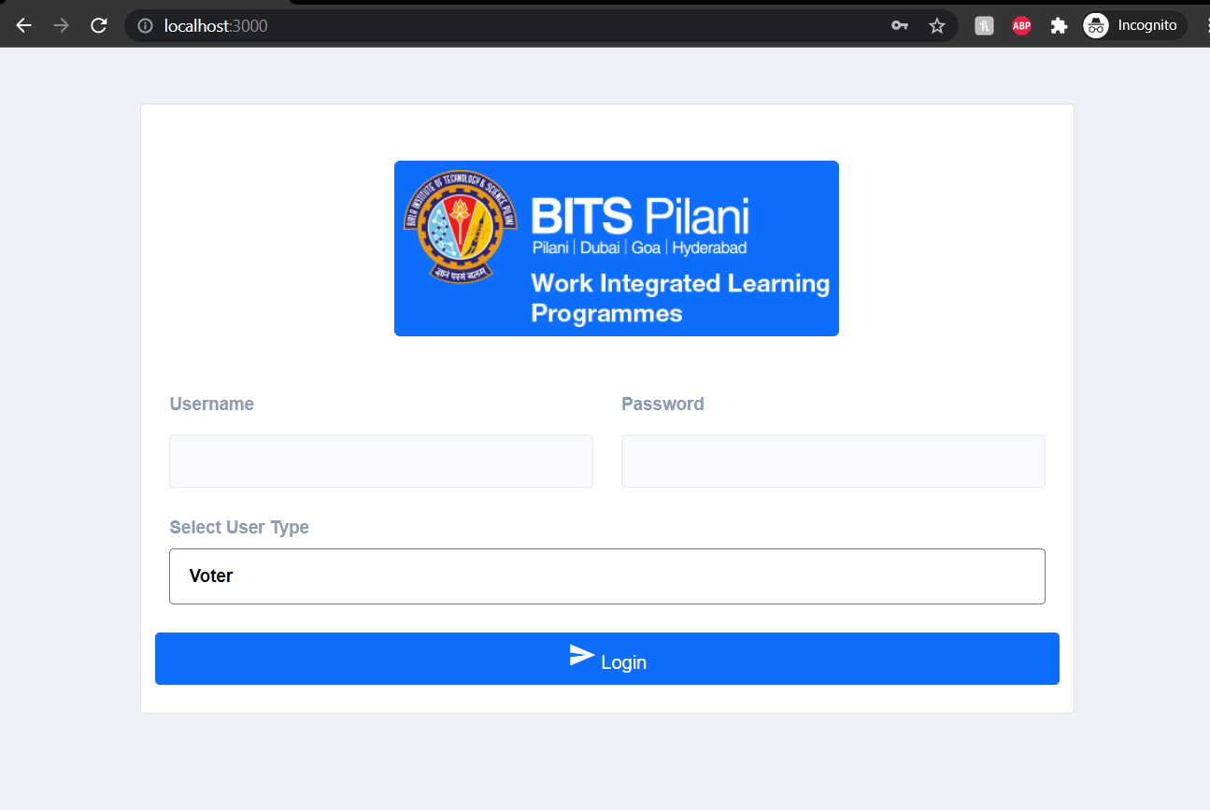
Login as Voter
A voter can login to the application by selection the user type as Voter
The valid Username will be the same name the provided while creating Voter (by admin)
As of now the default password is 12345.

Slide 17
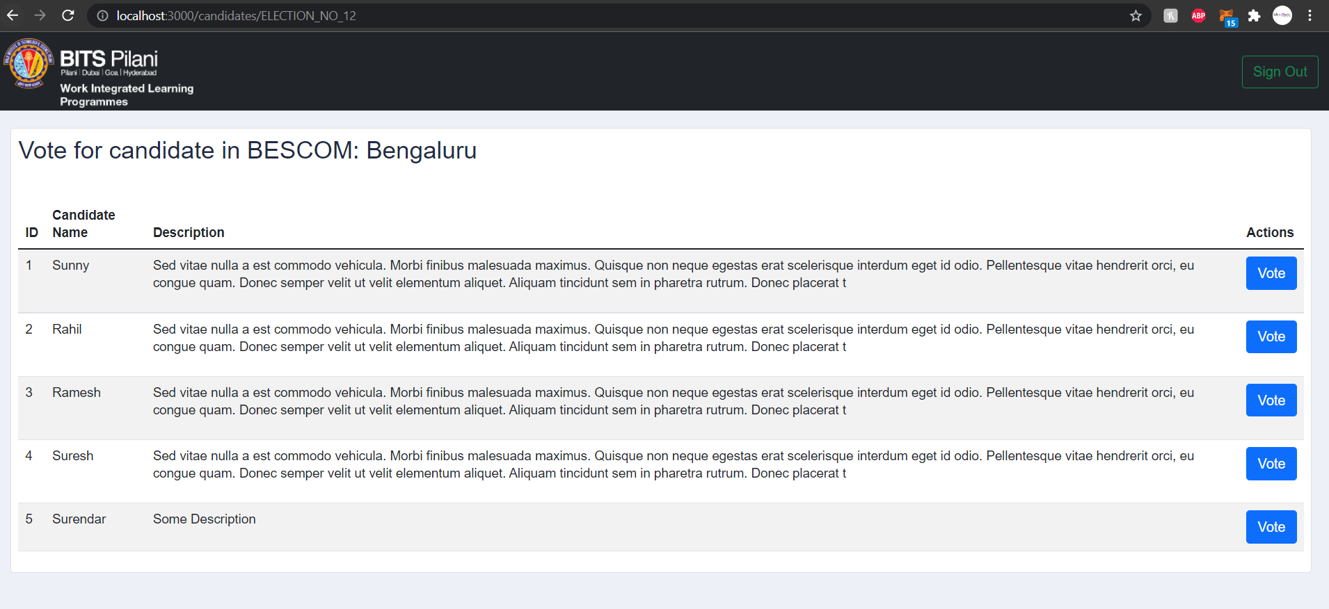
Voter Login: Vote for Candidate
When the Voter logs in, then the list of candidates will be displayed.
One can cast the vote for any set of the listed candidates.
‘ONLY ONCE’.
The Double voting is restricted.

Slide 18
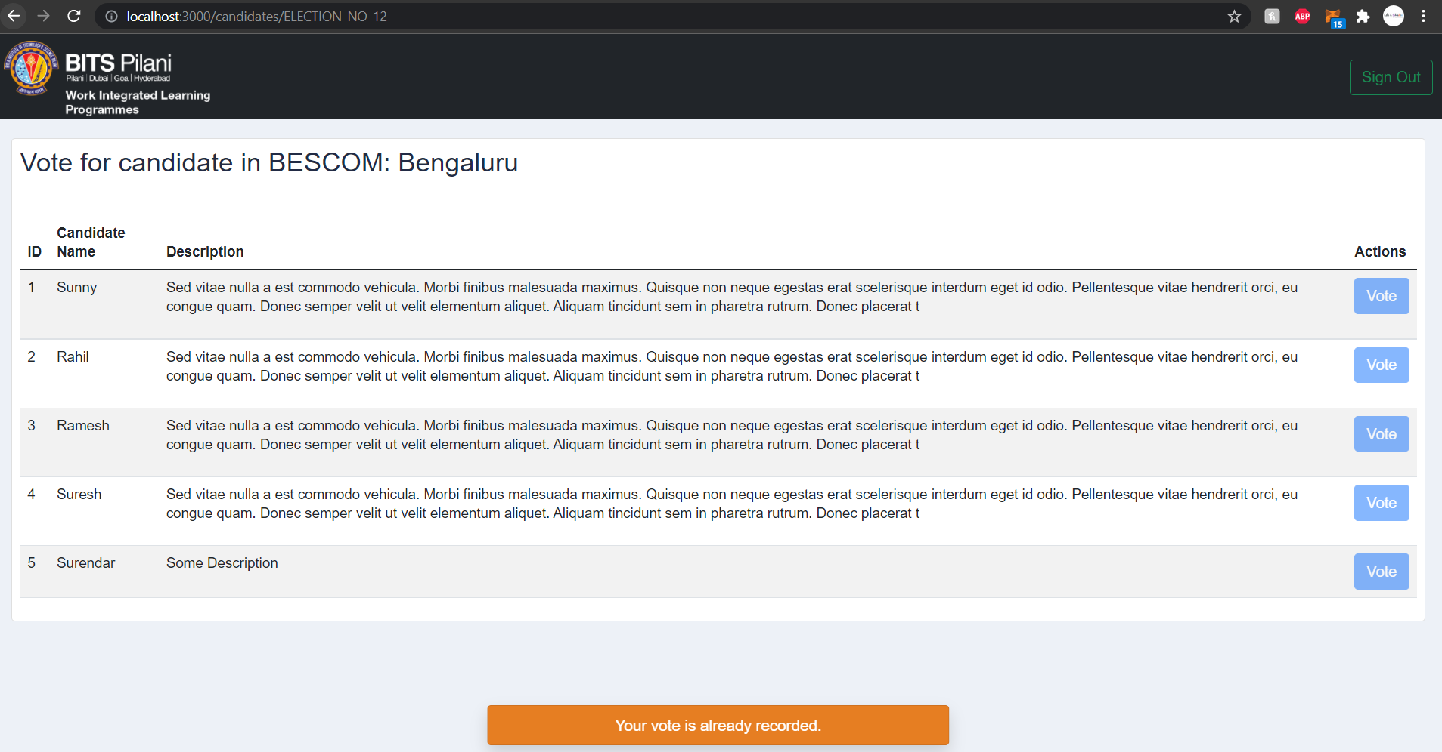
Candidate Login: Voted for Candidate
When a User tries to login again, then they will not be able to cast the vote.
It is almost not possible to change the vote, because of the advantage of blockchain, Data is Immutable.
The vote button will be disable.
The total number of votes casted can be seen in admin page.

Slide 19

Explanation for Smart contracts

Slide 20
Smart contracts
In this DAPP we have used two smart contracts (./src/contracts)
Election.sol
Migration.sol
Election.sol
This contract holds the model to store election details like
election name
List of candidates and their details (id, name, desc, voteCount, candidatesCount)
List of voters and their details (id, name, desc, hasVoted, votersCount)
Also, the methods to cast vote, add voter, add candidate
Migration.sol
This is generated (automatically) when we do truffle migrate for the first time.

Slide 21
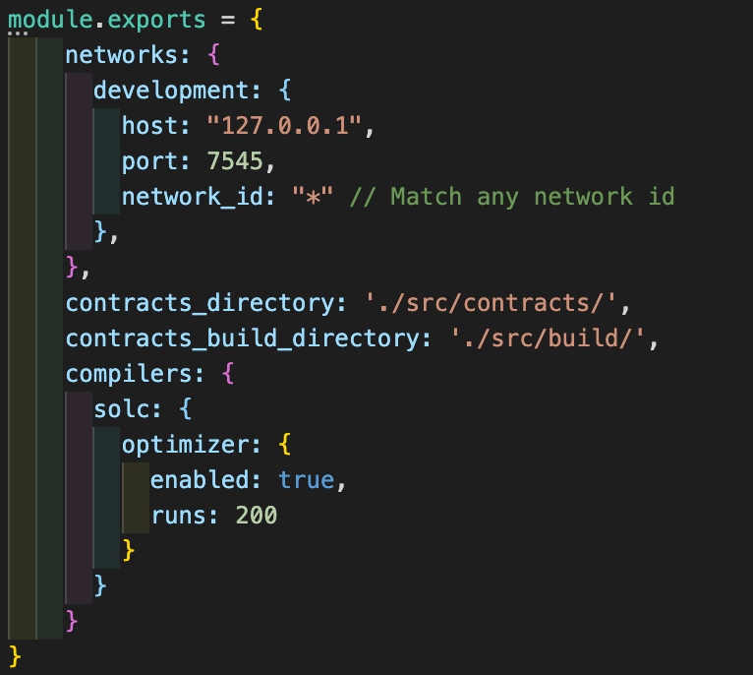
Revealing truffle-config.js
The deployment is done in localhost, port 7545
This is the same port where ganache RPC is running
The built contracts are generated once contracts are migrated.

Slide 22
How to run truffle contracts in console
Considering the pre-requisites (truffle), one can use terminal to deploy, and make changes to blockchain data using smart contracts.
In order to do so, please follow these steps:
Make sure you are in the project directory (../Blockchain-EVoting-UI) (Project Link available in the last slide)
To deploy the smart contract, use the following command `truffle migrate --reset`
To start the truffle console, type in `truffle console`
Now, we are good to start with command-line instructions to deal with smart conracts

Slide 23
Let us consider a real time scenario
For an election to be conducted,
We need ‘n’ number of candidates enrolled for the election.
We need ‘n’ number of valid voters to cast their vote for the enrolled candidates.
Important: A voter can cast their vote only once, NO DUPLICATE VOTING
The one with the Maximum number of votes will win the election.
Let us consider a similar scenario.
We will be creating an Election-block, to which we will add three voters and three candidates.
Let’s see who wins the election.

Slide 24
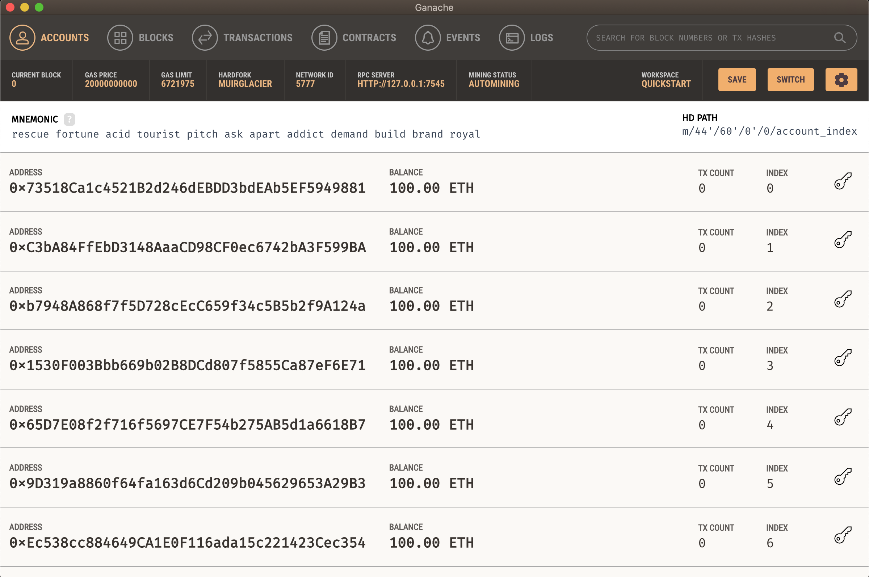
Ganache UI: Create workspace
Make sure that ganache UI is up and running.
We can also make use of ganache-cli. Use following command to install in local `npm install ganache-cli`
Once ganache is up we can proceed with truffle commands

Slide 25
Truffle console commands
Step | Command | Description
1 | truffle migrate --reset | Deploys the smart contract to Ethereum network
2 | truffle console | To start the truffle console
3 | Election.deployed().then((instance) => {app = instance}) | To get the Election object (the deployed contract is a promise)
4 | app.addCandidate(‘CANDIDATE_1', 'Name is Sunny') | To add a new candidate NOTE: Replace name and description appropriately
5 | app.candidatesCount() | To get the count of candidates added
6 | app.addVoter('VOTER_1', 'Name is Surendar') | To add a new candidate NOTE: Replace name and description appropriately
7 | app.votersCount() | To get the count of voters added
8 | app.vote(1,1) | To cast a vote for a candidate by a voter NOTE: the arguments are func vote(voter_id, candidate_id) as stored in blockchain

Slide 26
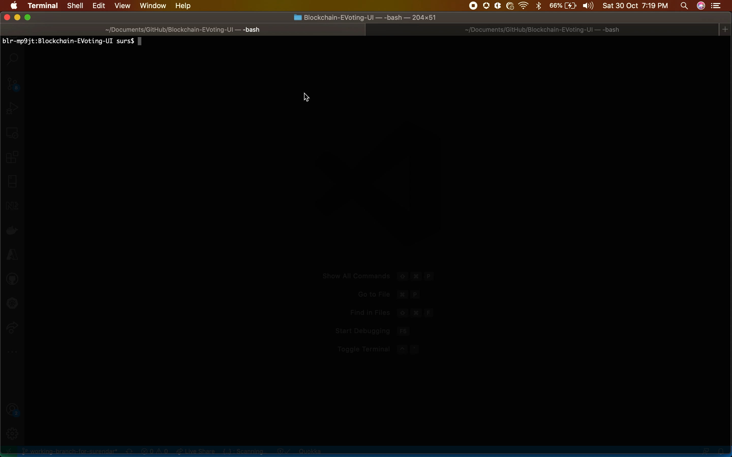
Migration of smart contracts
Summary
Total deployments: 2
Final cost: 0.02391962 ETH

Slide 27
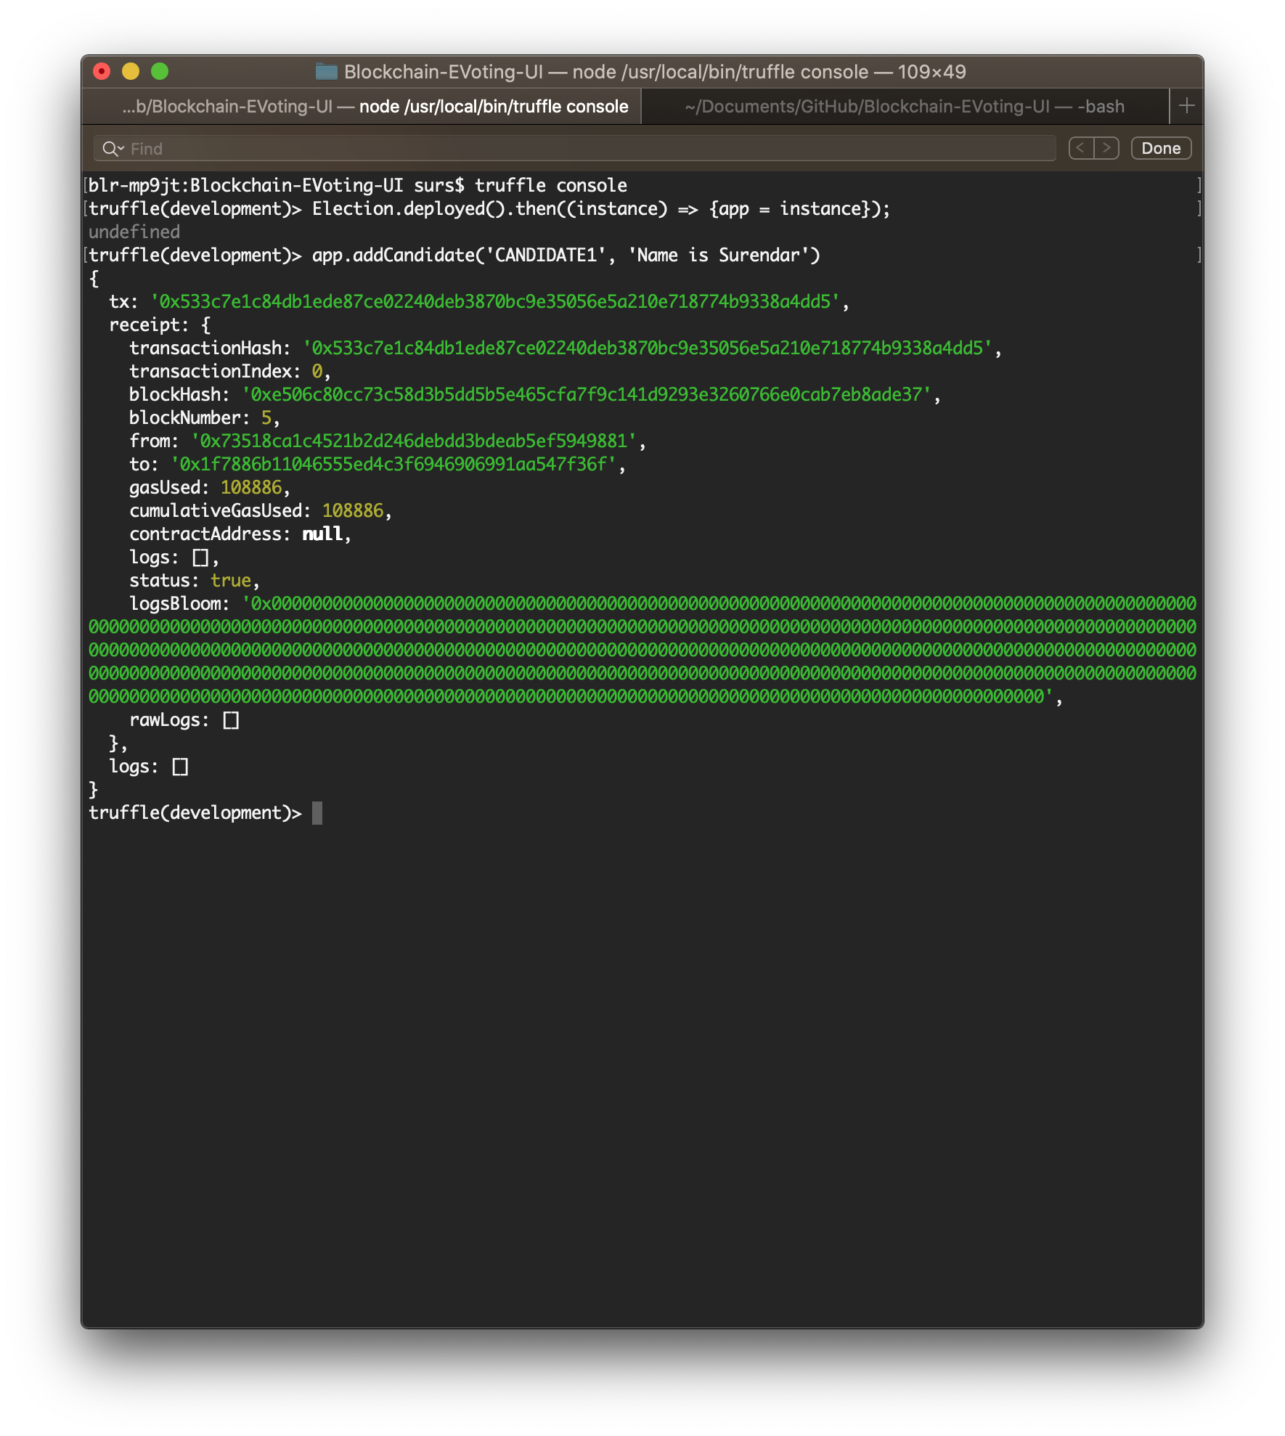
Add Candidate
Start the Truffle console
Get the Election object by resolving the promise
Now add 3 candidates.
For each addition of candidates, a transaction will be made to the Election block address.
The data will be stored in the block.
This method is integrated in the UI using web3.js to add candidates for an election by admin.
The candidate voteCount is set to ‘0’ initially.

Slide 28
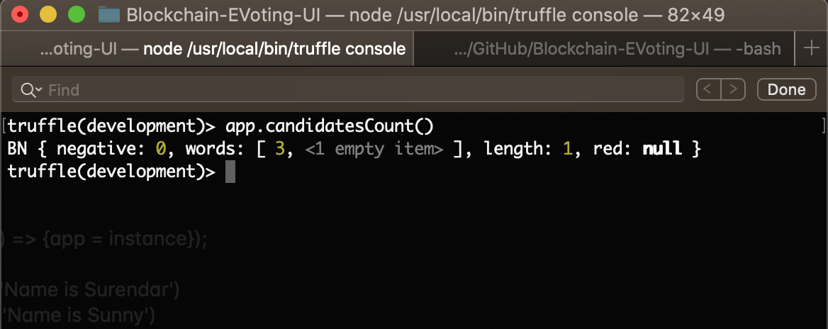
Get the count of Candidates
Once the candidates are added we can fetch the total number of candidates added
This method is helpful in case of UI integration.
The candidates are stored in (candidate id => Candidate struct) `mapping uint => Candidate`
This method has been used in UI to fetch and populate the Total candidates in Voters’ page and admin page (manage candidates)
In this case the Candidate count is 3, as per the considered scenario.

Slide 29
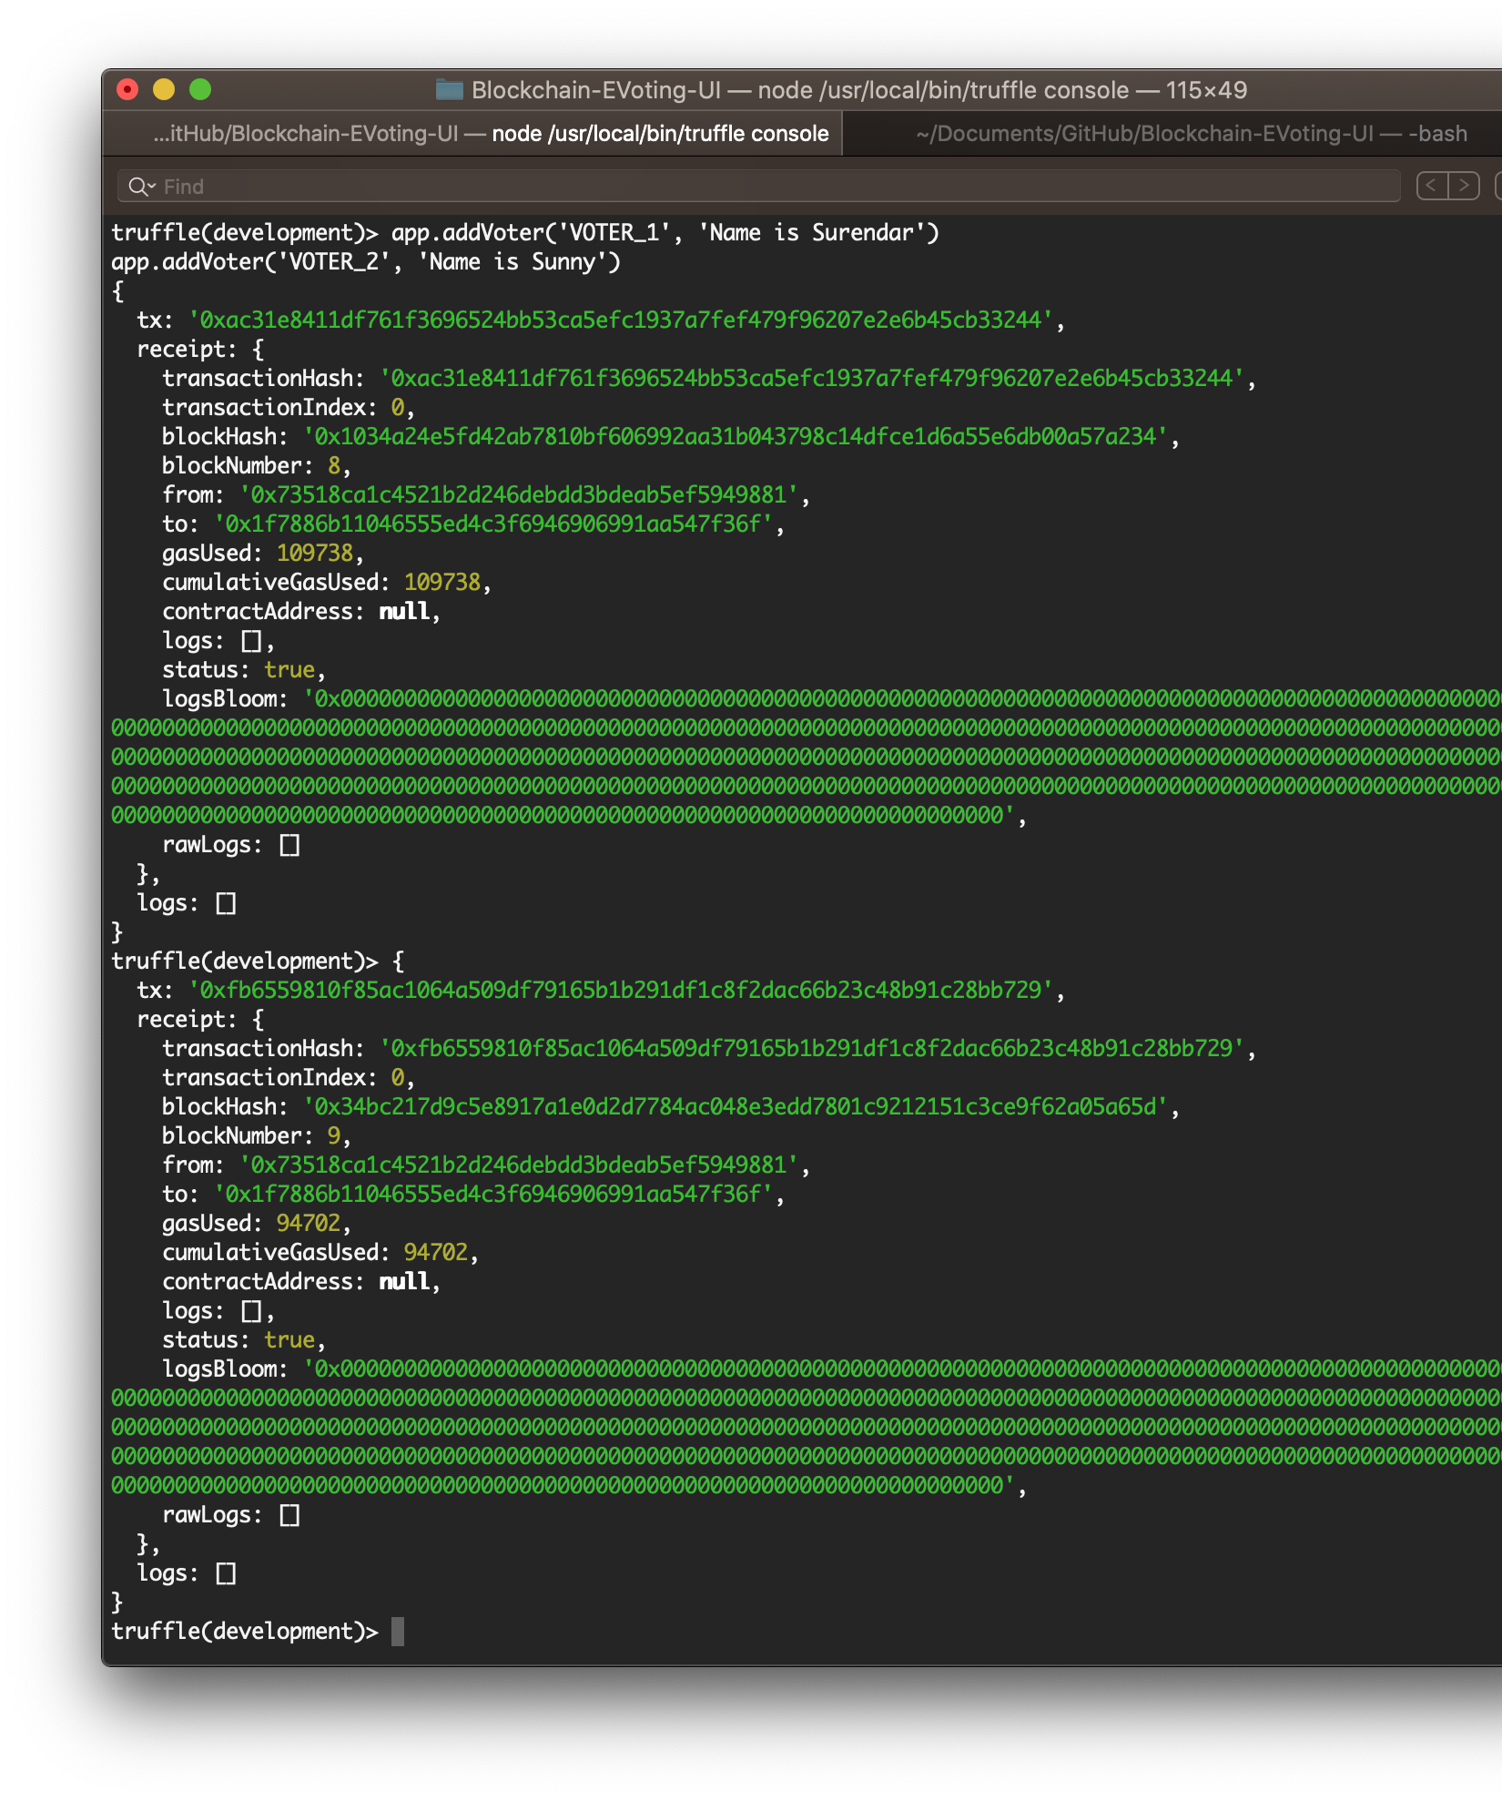
Add Voter
Now add 3 Voters.
For each addition of voters, a transaction will be made to the Election block address.
The data will be stored in the block.
This method is integrated in the UI using web3.js to add Voters for an election by admin.
The voter’s “hasVoted” field is set to false initially
This will be toggled when a vote is caseted.

Slide 30
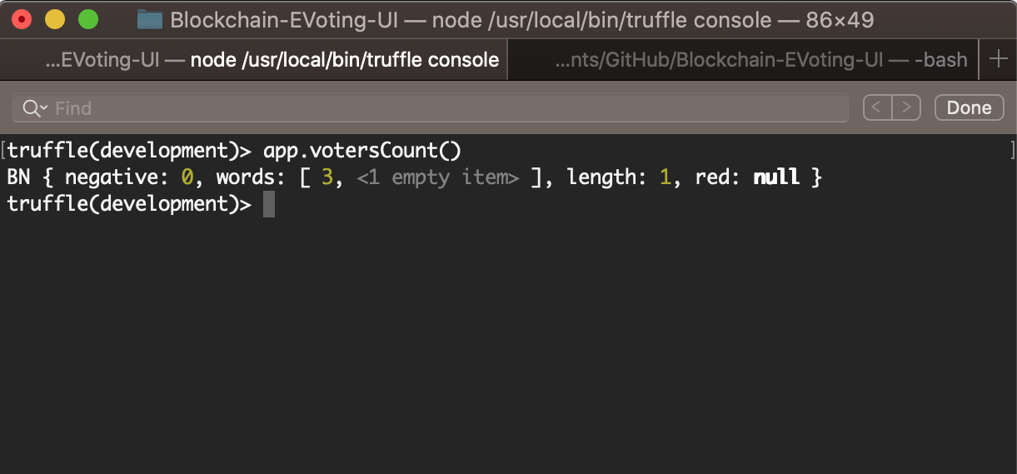
Get the count of Voters
Once the voters are added we can fetch the total number of candidates added
This method is helpful in case of UI integration. (Admin page)
The candidates are stored in mapping (voter id => Voter struct) `mapping uint => Voter`
This method has been used in UI to fetch and populate the Total candidates in admin page (manage voters)
Here the voters count is 3, as per the considered scenario.

Slide 31
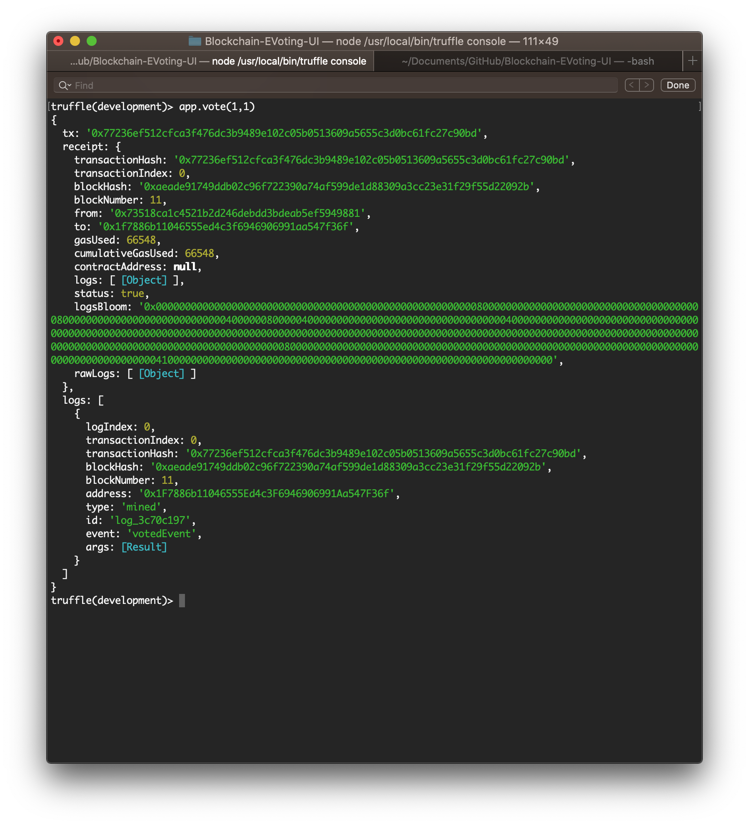
Now lets cast the vote…
We can make use of the function `vote(voter_id, cand_id)` to cast the vote.
A voter can cast vote only once, as the hasVoted value will be set true after voting.
In this scenario, the voter with id 1 (VOTER1) is casting the vote for the candidate with id 1 (Surendar).
Similarly, voter 2 to candidate 1 and voter 3 to candidate 2, has casted their corresponding votes.

Slide 32
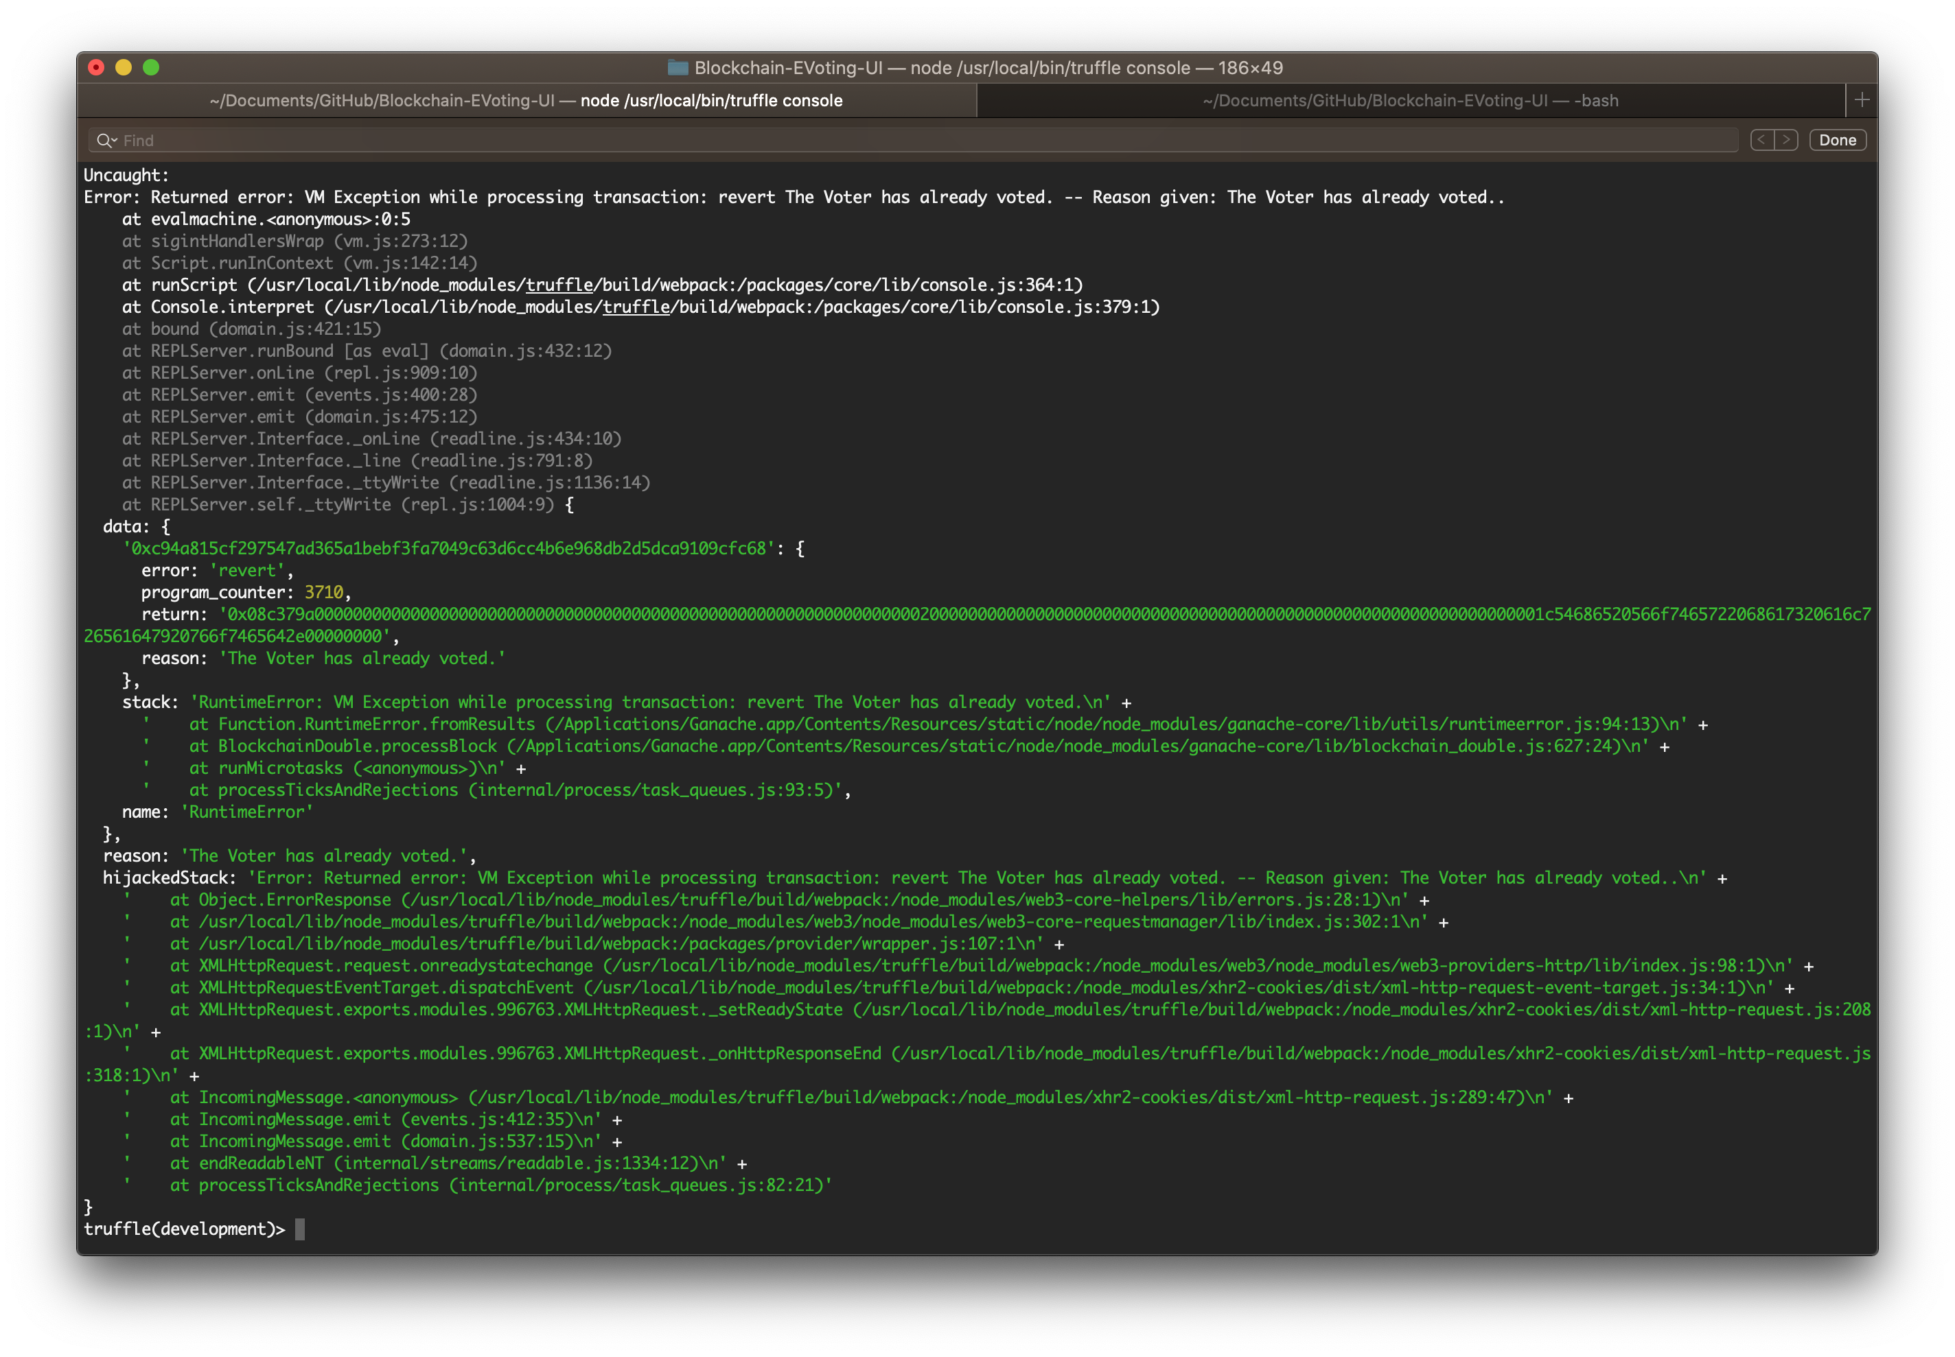
What happens when a voter tries to cast a vote again…?
When a voter who already casted a vote tries to vote again, they will not be able to vote.
We have added a validation check `require(!voterList[_voterId].hasVoted, 'The Voter has already voted.');`
Hence, `The Voter has already voted.` message will be thrown as an error and the transaction will be failed.

Slide 33
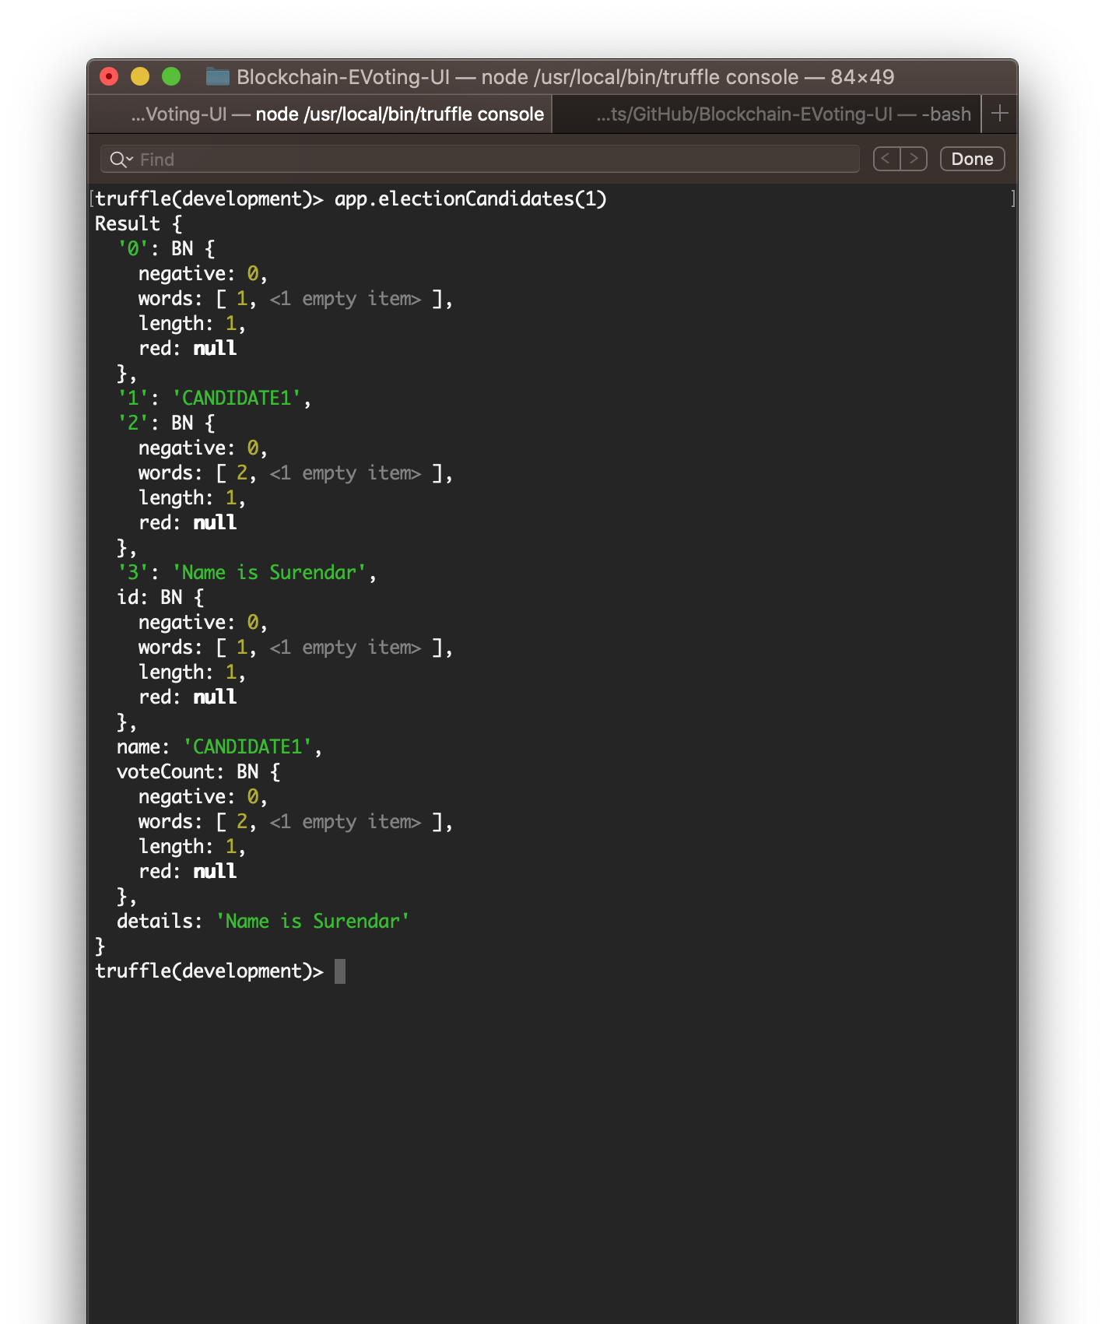
The candidate 1 has won the election…👏🏻
The candidate 1 got 2 votes, candidate 2 got 1 vote and candidate 3 got no vote.
The member var, voteCount has been used in UI to show the vote count for a candidate.
And this is how the smart contracts work.

Slide 34
Objectives that we achieved
Made the vote counting easier.
Since we make use of blockchain to store the data, it is immutable hence it adds security to the process workflow.
Avoidance of waiting for my turn to cast my vote, since the process has been automated now.

Slide 35
Scope and Extensions
Scope/ Limitations
The scope of this Application is restricted to one election per admin.
An admin can organize only a single election.
Extensions
This can be extended in such a way that, the smart contracts can be split into three different entities
Election (indexed with address)
Candidates (referenced with election address)
Voters (referenced with election address)

Slide 36
Contribution split
Surendar S (2020MT93162)
API application For login
Worked on smart contracts
Worked on integrating UI application with web3.js (Few modules: Like adding a new Candidate)
Sunny Khanuja (2020MT93110)
Worked entirely setting up UI project
Also, worked on Integrating the UI application
Overall, it was a collaborative work. We followed parallel coding.

Slide 37
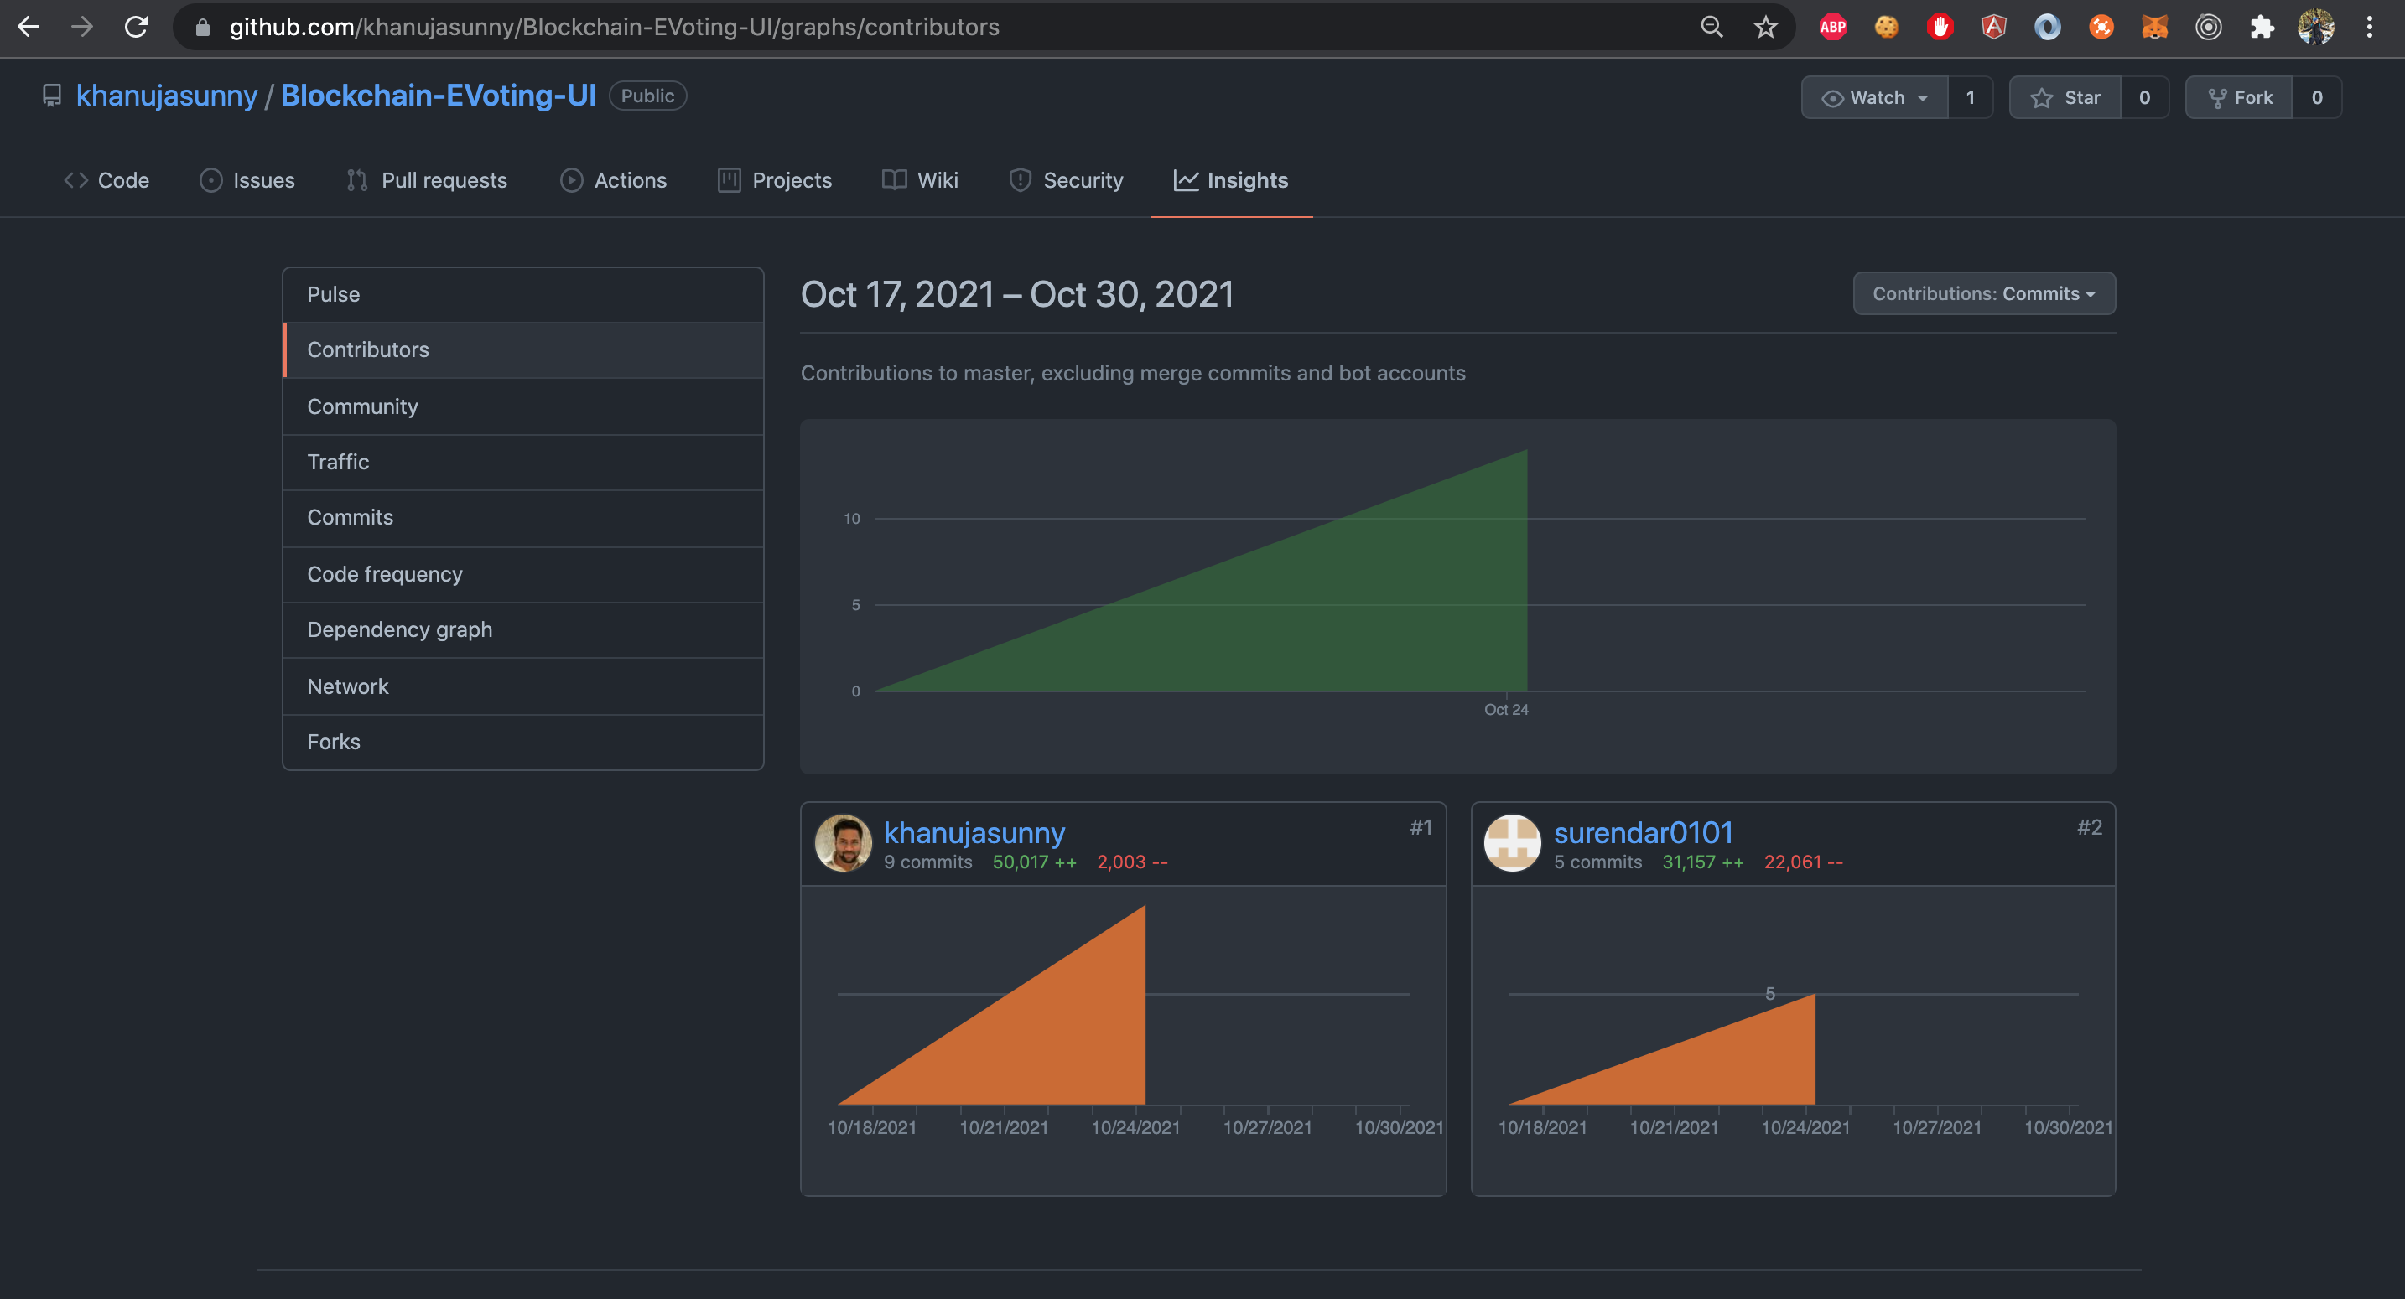
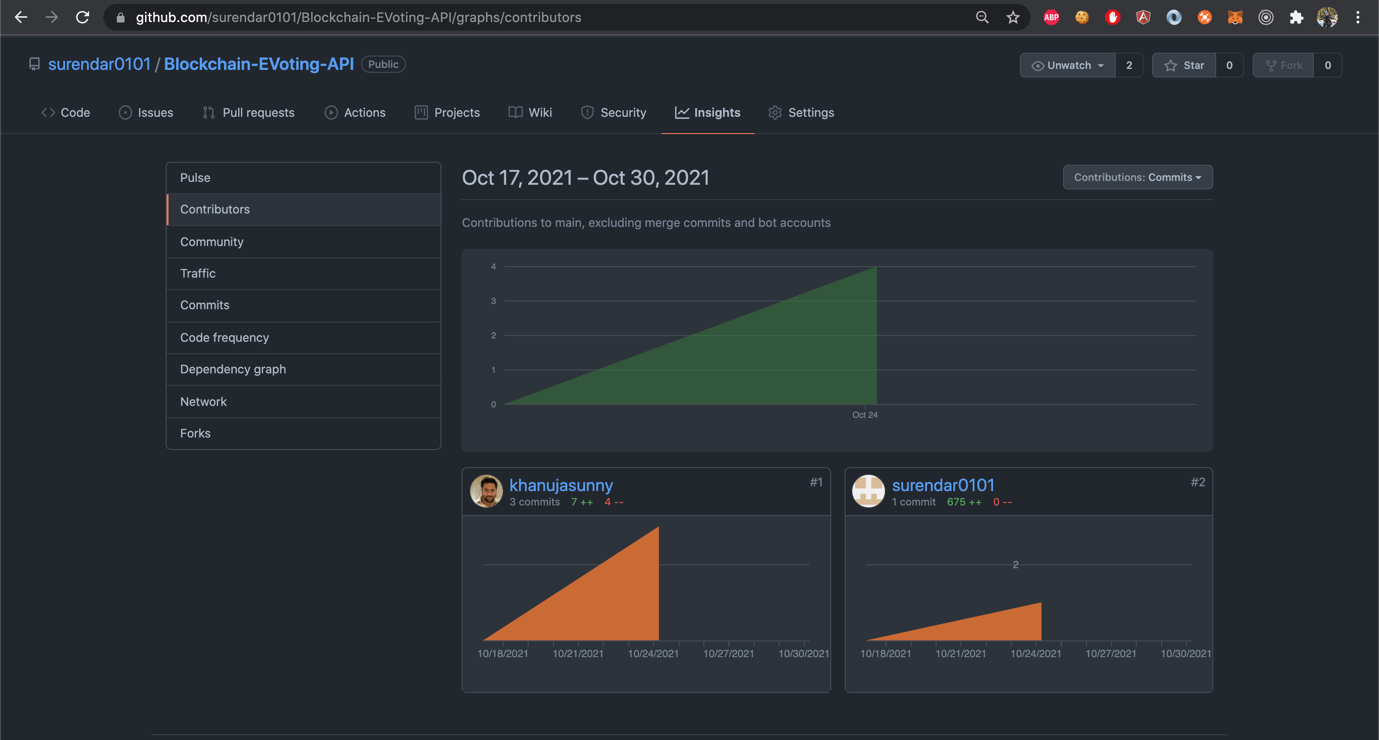
Work contribution (UI and API)

Slide 38
Learnings
Working on smart contracts was something which gave us a lot of learning.
The assignments gave us a lot of learning when compared to the theoretical content.
Since we got to work practically, this gave us more understanding.
The online lectures to work with metamask, ganache, Ethereum solidity added more learning.
Overall, it was something new that we learnt.

Slide 39



Links
Github:
UI Application: https://github.com/khanujasunny/Blockchain-EVoting-UI
API Application: https://github.com/surendar0101/Blockchain-EVoting-API
Explanation Video:
(contains detailed workflow and code explanation)
https://drive.google.com/drive/u/1/folders/1OjIGRGbXGS1qT2LlQEPOWEb1IZ8n_geh

Slide 40
Thank you

